Slide 1
UPPER SIXTH ARTS
GEOGRAPHY
Lesson 11
The Modern Demographic Explosion and Population Policies
Notes:
Good morning, class, and welcome to our geography lesson. I am your geography teacher, Mr Kamdem. Today we are starting Lesson 11: The Modern Demographic Explosion and Population Policies.

Slide 2
CLASS INFO
Class, Chapter and Duration
Class | Upper Sixth Arts
Chapter | Module 4: Understanding and managing population dynamics across the world in general and Cameroon in particular
Duration | 2 periods (2 × 50 minutes)
Notes:
This lesson is for Upper Sixth Arts. It belongs to Module 4: Understanding and managing population dynamics across the world in general and Cameroon in particular. We shall need 2 periods to cover it.

Slide 3
IDENTIFICATION
Lesson Identification
Topic | Population Change over Time (Population Growth)
Sub-topic | Population Growth
Lesson | Lesson 11: The Modern Demographic Explosion and Population Policies
Notions / Concepts | Demographic explosion, Green Revolution, pro-natalist policy, anti-natalist policy, one-child policy, migration laws, points-based system.
Syllabus focus | The modern demographic explosion: causes and consequences; management of growth: pro-natalist policies, anti-natalist policies (the Chinese experience) and migration laws.
Competence | Learners are able to explain the causes and consequences of rapid population growth and to evaluate population policies.
Notes:
Our topic is Population Change over Time (Population Growth), and the sub-topic is Population Growth. The key notions we shall use today are: demographic explosion, Green Revolution, pro-natalist policy, anti-natalist policy, one-child policy, migration laws, points-based system. At the end, you should be able to do this: learners are able to explain the causes and consequences of rapid population growth and to evaluate population policies.

Slide 4

HOMEWORK CORRECTION
Correction of the Homework
Question (Lesson 10: Factors of Population Growth):
Define a pro-natalist policy.
Notes:
Before we start the new lesson, let us correct the homework I gave you at the end of Lesson 10: Factors of Population Growth. The question was: Define a pro-natalist policy. Take out your exercise books.

Slide 5
HOMEWORK CORRECTION
Correction: Possible Answer
A pro-natalist policy is a government policy that encourages people to have more children.
Notes:
Here is a good answer. A pro-natalist policy is a government policy that encourages people to have more children. Compare it with your own answer and correct your work in red.

Slide 6
LESSON PLAN
Lesson Plan
Correction of the homework
Objectives and recall
Real-life situation and action to take
Learning activities
Board summary
Evaluation, remediation and homework
Notes:
Here is the plan of our lesson today. First, we shall correct the homework. Then we shall look at the objectives and recall what you already know. After that, we shall study a situation from real life and the action to take, and do the learning activities. Finally, we shall copy the board summary, do the evaluation and the remediation, and I will give you the homework.

Slide 7
OBJECTIVES
Objectives
By the end of this lesson, you should be able to:
Define the demographic explosion.
Explain its causes.
Explain its positive and negative consequences.
Notes:
Take your time to copy this part; we will continue together.

Slide 8
OBJECTIVES
Objectives (continued)
Describe pro-natalist and anti-natalist policies with examples.
Describe restrictive and selective migration laws.
Notes:
By the end of this lesson, you should be able to do five things. Number 1: define the demographic explosion. Number 2: explain its causes. Number 3: explain its positive and negative consequences. Number 4: describe pro-natalist and anti-natalist policies with examples. Number 5: describe restrictive and selective migration laws.

Slide 9
PREVIOUS KNOWLEDGE
Previous Knowledge
Demographic factors include births, deaths and migration.
China had a one-child policy.
Cameroon grows by about 2.6 % a year.
Notes:
Let us first remember what you already know. Demographic factors include births, deaths and migration. China had a one-child policy. Cameroon grows by about 2.6 % a year. Keep this in mind, because we shall build on it today.

Slide 10
REAL-LIFE SITUATION
Situation in Real Life
Ibrahim lives on the edge of Garoua, on the road to Figuil.
When he was small, his quarter had a few houses among trees and farms.
Notes:
Take your time to copy this part; we will continue together.

Slide 11
REAL-LIFE SITUATION
Situation in Real Life (continued)
Today almost all the trees have been cut to build homes, the queue at the well is much longer, and his father complains that the price of firewood has doubled because it comes from further away.
Notes:
Take your time to copy this part; we will continue together.

Slide 12
REAL-LIFE SITUATION
Situation in Real Life (continued)
Ibrahim asks: "Why is everything so crowded, and what can a government do when the population grows too fast?"
Notes:
Listen carefully to this situation from real life. Ibrahim lives on the edge of Garoua, on the road to Figuil. When he was small, his quarter had a few houses among trees and farms. Today almost all the trees have been cut to build homes, the queue at the well is much longer, and his father complains that the price of firewood has doubled because it comes from further away. Ibrahim asks: "Why is everything so crowded, and what can a government do when the population grows too fast?" Think about it, because I am going to ask you some questions.

Slide 13
REAL-LIFE SITUATION
Situation: Question 1
What is the problem in the situation?
Notes:
Question 1: What is the problem in the situation? Think for a moment, then raise your hand to answer.

Slide 14
REAL-LIFE SITUATION
Answer
Ibrahim does not understand the causes and consequences of rapid population growth and how it can be managed.
Notes:
Good. Ibrahim does not understand the causes and consequences of rapid population growth and how it can be managed.

Slide 15
REAL-LIFE SITUATION
Situation: Question 2
What is happening to the population of Garoua?
Notes:
Question 2: What is happening to the population of Garoua? Think for a moment, then raise your hand to answer.

Slide 16
REAL-LIFE SITUATION
Answer
It is growing very fast: a demographic explosion.
Notes:
Good. It is growing very fast: a demographic explosion.

Slide 17
REAL-LIFE SITUATION
Situation: Question 3
What can a government do?
Notes:
Question 3: What can a government do? Think for a moment, then raise your hand to answer.

Slide 18
REAL-LIFE SITUATION
Possible Answer
Adopt population policies, such as family planning and education.
Notes:
Good. Adopt population policies, such as family planning and education.

Slide 19
ACTION TO TAKE
Action to Take
Save water and wood, and support education and family health programmes in your community.
Notes:
From this situation, the action we are working towards in this lesson is the following: save water and wood, and support education and family health programmes in your community.

Slide 20
JUSTIFICATION
Justification of the Lesson
This lesson helps us to understand the pressure of rapid growth on resources and the policies used by governments to manage it.
Notes:
Why is this lesson important for you? This lesson helps us to understand the pressure of rapid growth on resources and the policies used by governments to manage it.

Slide 21
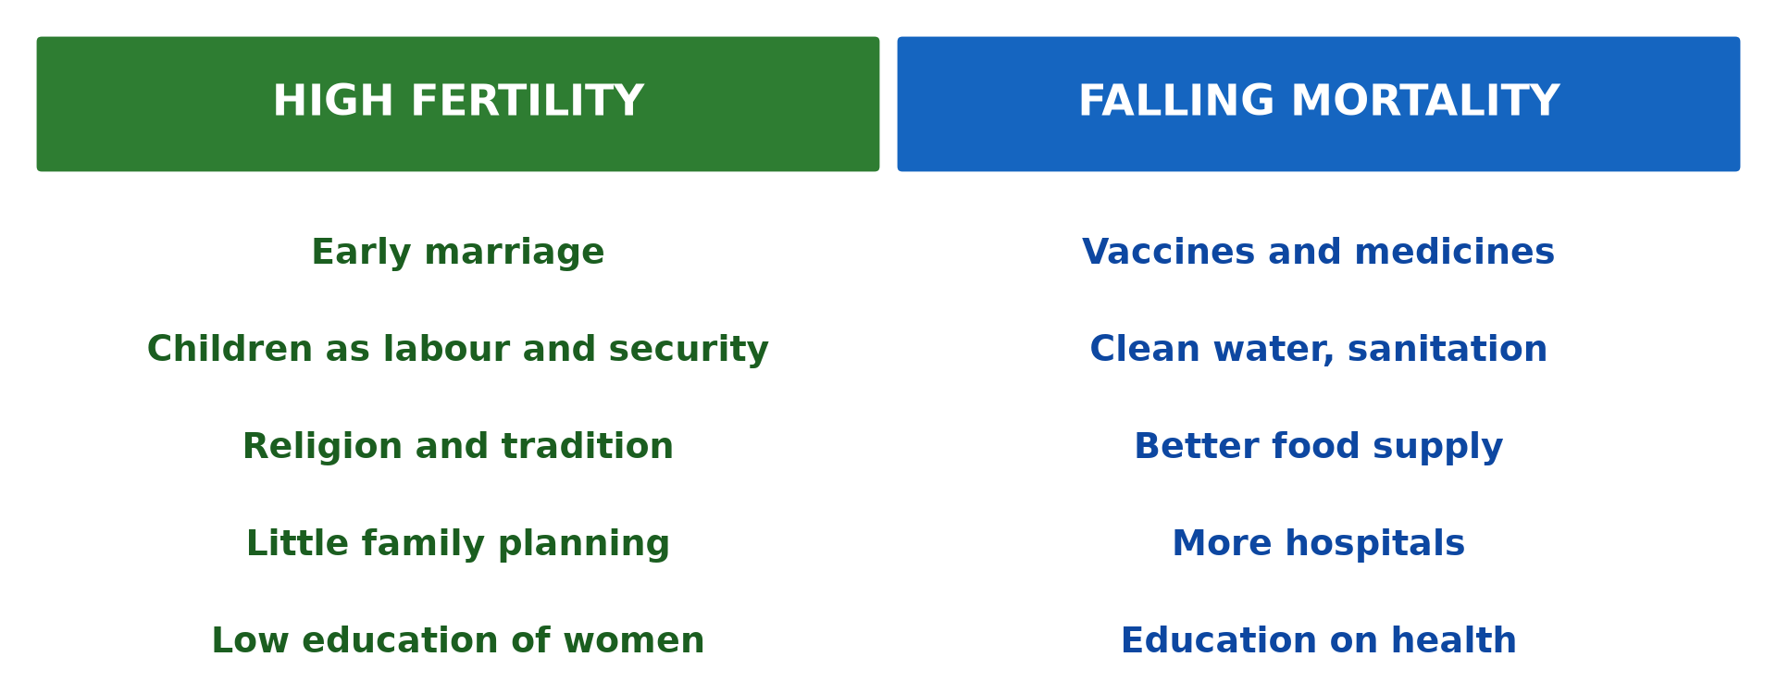
1. CAUSES
Activity 1
High fertility and falling mortality.
Notes:
Activity 1. Look carefully at this diagram: high fertility and falling mortality. Observe every detail before I ask the question.

Slide 22
1. CAUSES
Activity 1: Question
Give two causes of the demographic explosion.
Notes:
Here is the question for Activity 1: Give two causes of the demographic explosion. Take one minute to think and write your answer in your rough notebook.

Slide 23
1. CAUSES
Activity 1: Answer
Better medicine, sanitation and food supply, while births stay high (any two).
Notes:
Let us check the answer together. Better medicine, sanitation and food supply, while births stay high (any two).

Slide 24
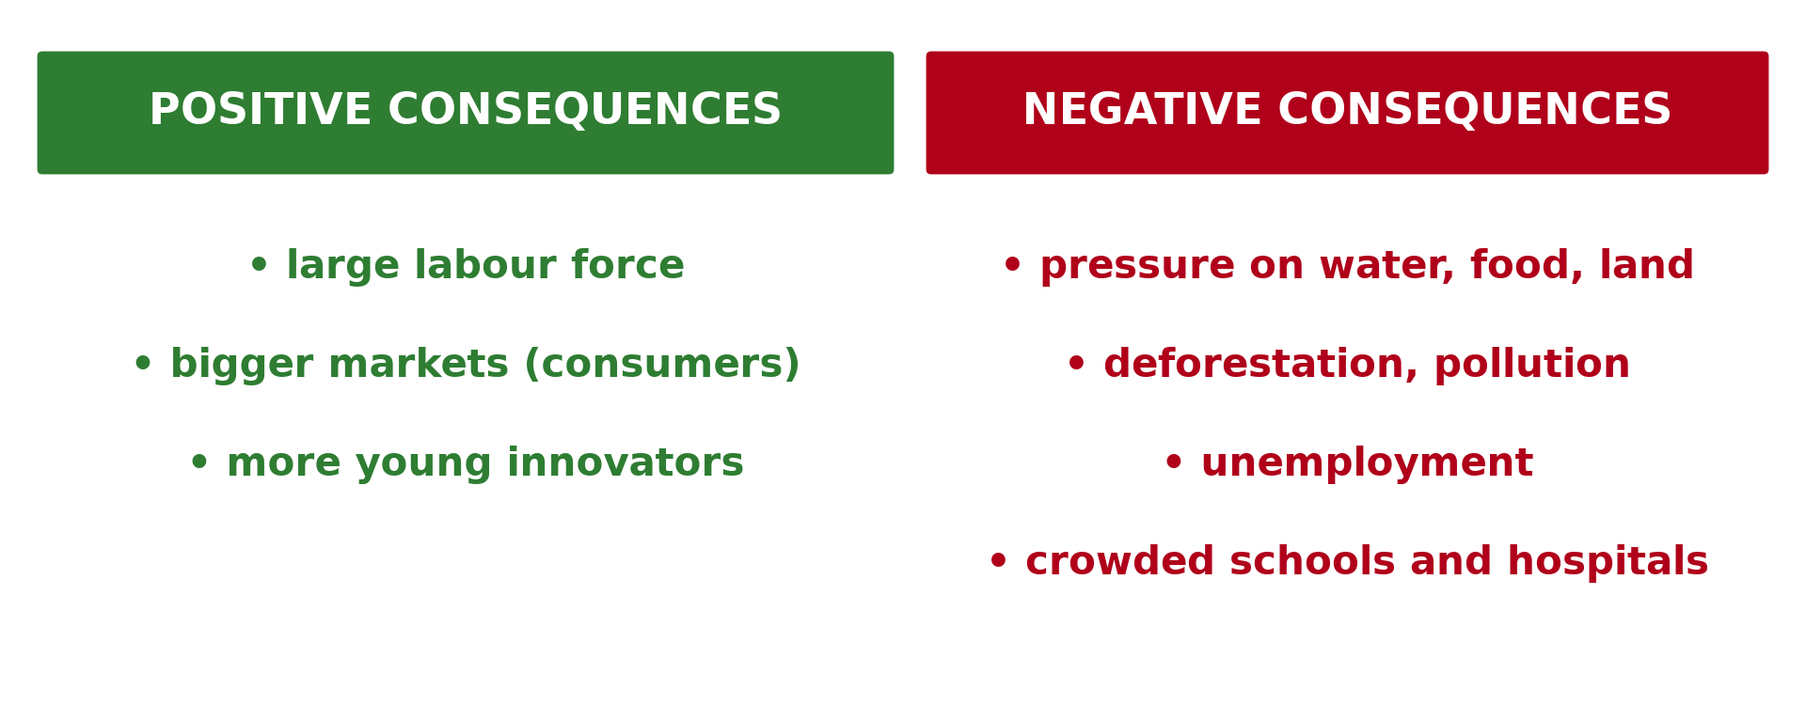
1. CONSEQUENCES
Activity 2
Consequences of rapid growth.
Notes:
Activity 2. Look carefully at this picture: consequences of rapid growth. Observe every detail before I ask the question.

Slide 25
1. CONSEQUENCES
Activity 2: Question
Give one positive and one negative consequence of rapid growth.
Notes:
Here is the question for Activity 2: Give one positive and one negative consequence of rapid growth. Take one minute to think and write your answer in your rough notebook.

Slide 26
1. CONSEQUENCES
Activity 2: Answer
Positive: a large labour force; negative: pressure on water and land.
Notes:
Let us check the answer together. Positive: a large labour force; negative: pressure on water and land.

Slide 27

1. CONSEQUENCES
Activity 3
Charcoal and firewood for sale.
Notes:
Activity 3. Look carefully at this picture: charcoal and firewood for sale. Observe every detail before I ask the question.

Slide 28
1. CONSEQUENCES
Activity 3: Question
Why is firewood becoming expensive around Garoua?
Notes:
Here is the question for Activity 3: Why is firewood becoming expensive around Garoua? Take one minute to think and write your answer in your rough notebook.

Slide 29
1. CONSEQUENCES
Activity 3: Answer
Trees near the town have been cut, so wood comes from further away.
Notes:
Let us check the answer together. Trees near the town have been cut, so wood comes from further away.

Slide 30
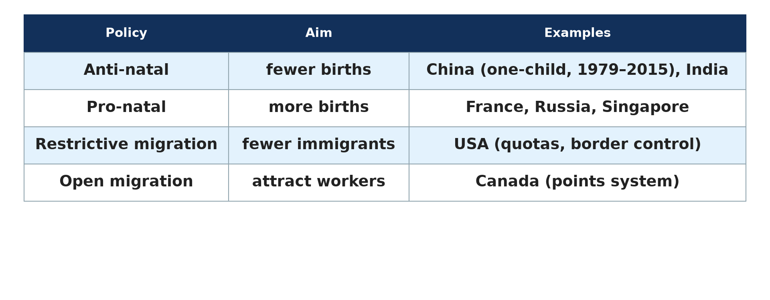
2. POLICIES
Activity 4
Population policies.
Notes:
Activity 4. Look carefully at this diagram: population policies. Observe every detail before I ask the question.

Slide 31
2. POLICIES
Activity 4: Question
Why does France have a pro-natalist policy?
Notes:
Here is the question for Activity 4: Why does France have a pro-natalist policy? Take one minute to think and write your answer in your rough notebook.

Slide 32
2. POLICIES
Activity 4: Answer
Because its birth rate is low and its population is ageing.
Notes:
Let us check the answer together. Because its birth rate is low and its population is ageing.

Slide 33
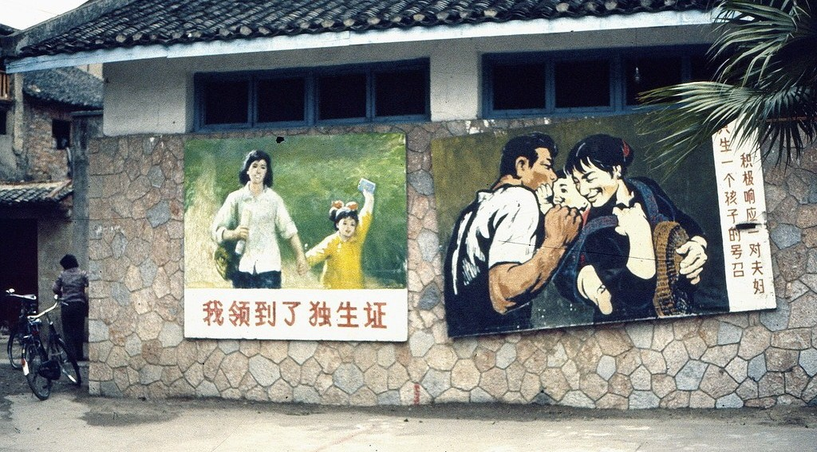
2. POLICIES
Activity 5
A family policy poster in China.
Notes:
Activity 5. Look carefully at this picture: a family policy poster in China. Observe every detail before I ask the question.

Slide 34
2. POLICIES
Activity 5: Question
Give one negative consequence of the one-child policy.
Notes:
Here is the question for Activity 5: Give one negative consequence of the one-child policy. Take one minute to think and write your answer in your rough notebook.

Slide 35
2. POLICIES
Activity 5: Answer
Too many boys compared with girls, and a rapidly ageing population.
Notes:
Let us check the answer together. Too many boys compared with girls, and a rapidly ageing population.

Slide 36
BOARD SUMMARY
Board Summary
Topic: Population Change over Time (Population Growth)
Sub-topic: Population Growth
Lesson 11: The Modern Demographic Explosion and Population Policies
Notes:
Now we are going to copy the board summary. Write the title and the headings neatly in your notebooks. I will give you enough time for each slide, so do not rush.

Slide 37
BOARD SUMMARY
DEFINITIONS
The key terms of this lesson are defined as follows:
Demographic explosion: It is the very rapid and unprecedented growth of the world population in the 20th and 21st centuries.
Pro-natalist policy: It is a policy that encourages people to have more children.
Notes:
Let us copy the definitions. The key terms of this lesson are defined as follows. On this slide we have Demographic explosion and Pro-natalist policy. Write each point on a new line, with the key term first, and explain it in your own words when we revise. When you finish, we go to the next slide.

Slide 38
BOARD SUMMARY
DEFINITIONS (continued)
Anti-natalist policy: It is a policy that discourages large families in order to slow down growth.
Notes:
We continue with the definitions. On this slide we have Anti-natalist policy. Write each point on a new line, with the key term first, and explain it in your own words when we revise.

Slide 39
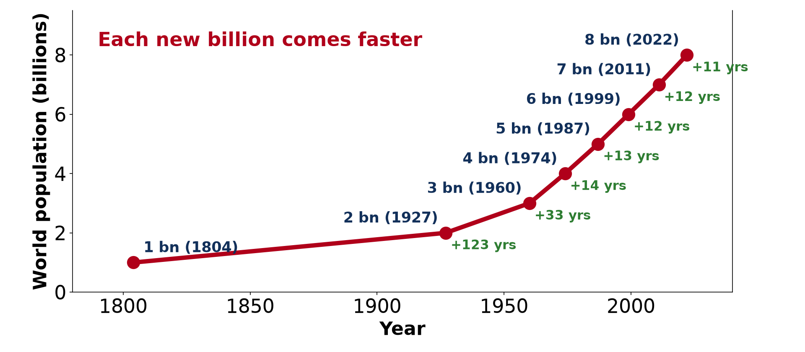
BOARD SUMMARY
1. The Modern Demographic Explosion
A) Causes
The causes of the demographic explosion are the following:
Scale: The world population rose from about 1.6 billion in 1900 to more than 8 billion today.
Illustration: the billions of people
Notes:
Let us copy Causes. The causes of the demographic explosion are the following. Copy the point on Scale on the left, then draw the diagram on the right: the billions of people. Give it a title and label it clearly.

Slide 40

BOARD SUMMARY
1. The Modern Demographic Explosion
A) Causes
Improved medical care: Vaccines, antibiotics and better surgery reduced deaths from diseases.
Illustration: vaccination
Notes:
Copy the point on Improved medical care on the left, then draw the diagram on the right: vaccination. Give it a title and label it clearly.

Slide 41
BOARD SUMMARY
1. The Modern Demographic Explosion
A) Causes
Improved sanitation: Clean water and sewers reduced cholera and typhoid.
More food: The Green Revolution (new seeds, fertilisers, irrigation) fed a much larger population.
Notes:
We continue with Causes. On this slide we have Improved sanitation and More food. Write each point on a new line, with the key term first, and explain it in your own words when we revise. When you finish, we go to the next slide.

Slide 42
BOARD SUMMARY
1. The Modern Demographic Explosion
A) Causes (continued)
High birth rates: In developing countries, births remain high because of traditions, limited family planning and the value of children.
Notes:
We continue with Causes. On this slide we have High birth rates. Write each point on a new line, with the key term first, and explain it in your own words when we revise.

Slide 43
BOARD SUMMARY
1. The Modern Demographic Explosion
B) Consequences
The consequences of the demographic explosion are the following:
Positive consequences:
A large labour force for industries and services.
Bigger markets that stimulate the economy.
Notes:
Let us copy Consequences. The consequences of the demographic explosion are the following. On this slide we have Positive consequences. Write each point on a new line, with the key term first, and explain it in your own words when we revise.

Slide 44
BOARD SUMMARY
1. The Modern Demographic Explosion
B) Consequences
Pressure on resources: Water, food, housing and energy run short, as firewood around Garoua.
Illustration: firewood and charcoal
Notes:
Copy the point on Pressure on resources on the left, then draw the diagram on the right: firewood and charcoal. Give it a title and label it clearly.

Slide 45
BOARD SUMMARY
1. The Modern Demographic Explosion
B) Consequences
Environmental damage: Deforestation, pollution and loss of biodiversity increase.
Unemployment: The economy does not create jobs fast enough for all the young people.
Notes:
We continue with Consequences. On this slide we have Environmental damage and Unemployment. Write each point on a new line, with the key term first, and explain it in your own words when we revise.

Slide 46
BOARD SUMMARY
1. The Modern Demographic Explosion
B) Consequences
Overcrowding: Schools, hospitals and public transport are overloaded.
Illustration: consequences of rapid growth
Notes:
Copy the point on Overcrowding on the left, then draw the diagram on the right: consequences of rapid growth. Give it a title and label it clearly.

Slide 47
BOARD SUMMARY
2. Managing Population Growth
A) Pro-Natalist Policies
Pro-natalist policies are presented as follows:
Aim: They encourage births in countries with low fertility and ageing populations.
Illustration: population policies
Notes:
Let us copy Pro-Natalist Policies. Pro-natalist policies are presented as follows. Copy the point on Aim on the left, then draw the diagram on the right: population policies. Give it a title and label it clearly.

Slide 48
BOARD SUMMARY
2. Managing Population Growth
A) Pro-Natalist Policies
Example of France: It offers paid parental leave, cheap childcare and family allowances, which are larger from the third child.
Notes:
We continue with Pro-Natalist Policies. On this slide we have Example of France. Write each point on a new line, with the key term first, and explain it in your own words when we revise. When you finish, we go to the next slide.

Slide 49
BOARD SUMMARY
2. Managing Population Growth
A) Pro-Natalist Policies (continued)
Other examples: Russia, Singapore and South Korea give money and other advantages to parents.
Notes:
We continue with Pro-Natalist Policies. On this slide we have Other examples. Write each point on a new line, with the key term first, and explain it in your own words when we revise.

Slide 50
BOARD SUMMARY
2. Managing Population Growth
B) Anti-Natalist Policies: the Chinese Experience
The Chinese anti-natalist policy is presented as follows:
Aim: Anti-natalist policies slow down growth in countries where population grows too fast.
Notes:
Let us copy Anti-Natalist Policies: the Chinese Experience. The Chinese anti-natalist policy is presented as follows. On this slide we have Aim. Write each point on a new line, with the key term first, and explain it in your own words when we revise.

Slide 51
BOARD SUMMARY
2. Managing Population Growth
B) Anti-Natalist Policies: the Chinese Experience
The one-child policy: From about 1980 to 2015, most Chinese couples were allowed only one child.
Illustration: a family policy poster
Notes:
Copy the point on The one-child policy on the left, then draw the diagram on the right: a family policy poster. Give it a title and label it clearly.

Slide 52
BOARD SUMMARY
2. Managing Population Growth
B) Anti-Natalist Policies: the Chinese Experience
Incentives and penalties: Obedient families received better housing and free education, while others paid fines and faced social pressure.
Results:
Growth slowed down sharply.
Notes:
We continue with Anti-Natalist Policies: the Chinese Experience. On this slide we have Incentives and penalties and Results. Write each point on a new line, with the key term first, and explain it in your own words when we revise. When you finish, we go to the next slide.

Slide 53
BOARD SUMMARY
2. Managing Population Growth
B) Anti-Natalist Policies: the Chinese Experience (continued)
Many more boys than girls were born.
The population aged rapidly.
China now allows three children per couple.
Notes:
We continue with Anti-Natalist Policies: the Chinese Experience. Copy this carefully.

Slide 54
BOARD SUMMARY
2. Managing Population Growth
C) Migration Laws
Migration laws are used as follows:
Restrictive policies: Some countries limit immigration with strict visas, quotas and border controls, as in the USA and many European countries.
Notes:
Let us copy Migration Laws. Migration laws are used as follows. On this slide we have Restrictive policies. Write each point on a new line, with the key term first, and explain it in your own words when we revise. When you finish, we go to the next slide.

Slide 55
BOARD SUMMARY
2. Managing Population Growth
C) Migration Laws (continued)
Selective policies: Canada and Australia attract skilled workers with a points-based system (education, skills, languages).
Aim: Migration laws help to fill labour shortages or to protect jobs and services.
Notes:
We continue with Migration Laws. On this slide we have Selective policies and Aim. Write each point on a new line, with the key term first, and explain it in your own words when we revise.

Slide 56
FORMATIVE EVALUATION
Evaluation 1
Give two causes of the modern demographic explosion.
Notes:
Now let us check what you have understood. Question 1: Give two causes of the modern demographic explosion. Answer in your exercise book.

Slide 57
FORMATIVE EVALUATION
Expected Answer
Better medicine and sanitation, more food (Green Revolution), high birth rates in developing countries (any two).
Notes:
The expected answer is: better medicine and sanitation, more food (Green Revolution), high birth rates in developing countries (any two). If you got it right, well done.

Slide 58
FORMATIVE EVALUATION
Evaluation 2
Why would Japan adopt a pro-natalist policy and Niger an anti-natalist policy?
Notes:
Now let us check what you have understood. Question 2: Why would Japan adopt a pro-natalist policy and Niger an anti-natalist policy? Answer in your exercise book.

Slide 59
FORMATIVE EVALUATION
Expected Answer
Japan has low births and an ageing population; Niger has very high births and rapid growth.
Notes:
The expected answer is: japan has low births and an ageing population; Niger has very high births and rapid growth. If you got it right, well done.

Slide 60
REMEDIATION
Remediation
Fill in the blanks:
A policy that encourages births is ______.
China's one-child policy lasted until ______.
Canada selects immigrants with a ______ system.
Notes:
For those who need more practice, fill in the blanks in your exercise book. The answers are: number 1, pro-natalist; number 2, 2015; number 3, points-based.

Slide 61
HOMEWORK
Homework
Name the five stages of the demographic transition model.
Notes:
For your homework: Name the five stages of the demographic transition model. We shall correct it at the beginning of our next lesson.

Slide 62
NEXT LESSON
Next Lesson
Our next lesson will be on:
Lesson 12: The Demographic Transition Model
Notes:
Our next lesson will be on Lesson 12: The Demographic Transition Model. Thank you for your attention, and see you next time.

Slide 63
BILINGUAL GAME
Bilingual Game (Jeu Bilingue)
English | Français
Demographic explosion | L'explosion démographique
Pro-natalist policy | La politique nataliste
Anti-natalist policy | La politique antinataliste
Family planning | La planification familiale
Firewood | Le bois de chauffe
Quota | Le quota
Notes:
Let us play the bilingual game. I say a word in English, and you give me the French word. Then we do the reverse.

Slide 64
LOGBOOK
Official Logbook (1/2)
Module / Topic | Population Change over Time (Population Growth)
Lesson Title | Lesson 11: The Modern Demographic Explosion and Population Policies
Expected Learning Outcomes | Define the demographic explosion. Explain its causes. Explain its positive and negative consequences. Describe pro-natalist and anti-natalist policies with examples. Describe restrictive and selective migration laws.
Competence | Learners are able to explain the causes and consequences of rapid population growth and to evaluate population policies.
Notes:
I record this information in the official logbook of the class after the lesson.

Slide 65
LOGBOOK
Official Logbook (2/2)
Matter Taught | DEFINITIONS; Causes; Consequences; Pro-Natalist Policies; Anti-Natalist Policies: the Chinese Experience; Migration Laws.
Evaluation | Formative evaluation and remediation exercise.
Homework | Name the five stages of the demographic transition model.
Enrolment / Present / Absent | ____ / ____ / ____
Achievement | To be completed after the lesson.
Notes:
I complete the second page of the logbook: the matter taught, the evaluation, the homework and the attendance.

Slide 66
TEACHER'S NOTE
Teacher's Note
Timing: Homework correction, plan, objectives 8 min | Recall, situation, action 10 min | 5 activities 30 min | Board summary (copying) 30 min | Evaluation, remediation 10 min | Homework, next lesson 5 min | Logbook 7 min
Without the projector (Activity 1): list the causes on the board.
Without the projector (Activity 2): draw the two columns.
Without the projector (Activity 3): discuss the price of firewood.
Without the projector (Activity 4): write the policies in a table.
Without the projector (Activity 5): explain the policy.
Notes:
This slide is for me, the teacher: it gives the timing of the lesson and what to do if the projector is not available.

Slide 67
REFERENCES
References
Geography Syllabus for Sixth Forms (Lower and Upper Sixth), MINESEC, 2019 — Module 4 (Population Geography).
Teacher's course notes: Mr KAMDEM E., Population Geography (USA), GBHS Garoua, 2026.
United Nations, World Population Prospects 2024.
Photo, Activity 3: “Charcoal, made from tree branches” by World Bank Photo Collection, CC BY-NC-ND 2.0, via Flickr (https://www.flickr.com/photos/10816734@N03/25644159775)
Photo, Activity 5: “propaganda posters, one child policy” by kattebelletje, CC BY-NC 2.0, via Flickr (https://www.flickr.com/photos/97249369@N00/3349125321)
Photo, board summary (Improved medical care): “Isatu gets a vaccination for her 5 week old son” by World Bank Photo Collection, CC BY-NC-ND 2.0, via Flickr (https://www.flickr.com/photos/10816734@N03/26372818523)
Diagrams and animations: drawn for this lesson (Geography Department).
Notes:
These are the references and picture credits used to prepare this lesson.

